Slide 1
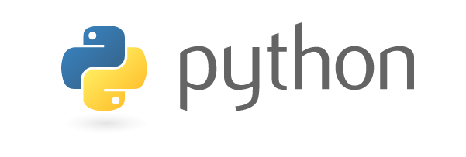
CHAPTER-SIX
GUI With Python Programming Language
By: Mikiale T.

Slide 2
Topics To Cover
We will be covering the following concepts:
What is a Graphical User Interface (GUI)?
Python Libraries to create GUIs
What is Tkinter?
Tkinter Widgets
Geometry Management
Organization of Layouts and Widgets
Binding Functions
Images and Icons
Use Case – Calculator Application using Tkinter

Slide 3
What Is A Graphical User Interface (GUI)?
Graphical User Interface (GUI) is nothing but a desktop application which helps you to interact with the computers.
GUI apps like Text-Editors create, read, update and delete different types of files.
Apps like Sudoku, Chess and Solitaire are games which you can play.
GUI apps like Google Chrome, Firefox and Microsoft Edge browse through the Internet.
Python has a excess of libraries to create GUI and these 4 stands out mainly when it comes to GUI. There are as follows:
Kivy
Python QT
wxPython
Tkinter
Among all of these, Tkinter is the first choice for a LOT of learners and developers just because of how simple and easy it is.

Slide 4
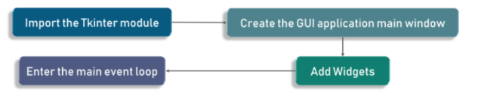
… Cont’d
Tkinter is actually an built-in Python module used to create simple GUI apps.
It is the most commonly used module for GUI apps in the Python.
You don’t need to worry about installation of the Tkinter module as it comes with Python as default.
Consider the following diagram, it shows how an application actually executes in Tkinter:
To start out with, we first import the Tkinter model.
Followed by that, we create the main window.
It is in main window that we are performing operations and displaying visuals and everything basically.
Later, we add the widgets and lastly we enter the main event loop.

Slide 5
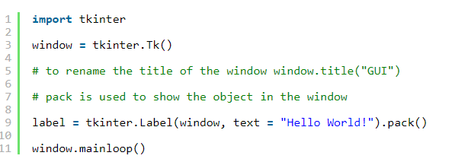
… Cont’d
If you noticed, there are 2 keywords here that you might not know at this point. These are the 2 keywords:
Widgets
Main Event Loop
An event loop is basically telling the code to keep displaying the window until we manually close it. It runs in an infinite loop in the back-end.
Check out the following code for better clarity:

Slide 6
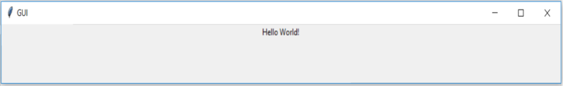
… Cont’d
As you see in the previous slide, we are importing the Tkinter package and defining a window.
Followed by that, we are giving a window title which is shown on the title tab whenever you open an application.So,we can call it anything we want based on the requirement.
Lastly, we have a label. A label defines what output needs to be shown on the window. In this case as you can already see, it is hello world.
Check out the output for the previous slide code:

Slide 7
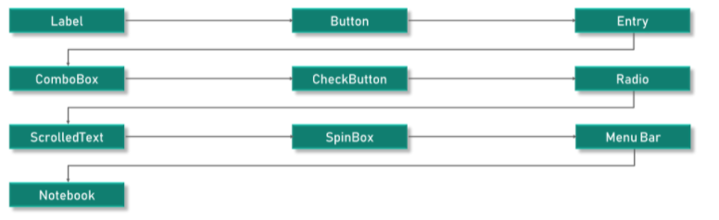
Tkinter Widgets
You will find different types of widgets to the different types of elements in the Tkinter.
Check out this diagram for the list of the majorly used Tkinter widgets:

Slide 8
… Cont’d
Canvas – Canvas is used to draw shapes in your GUI.
Button – Button widget is used to place the buttons in the Tkinter.
Checkbutton – Checkbutton is used to create the check buttons in your application. Note that you can select more than one option at a time.
Entry – Entry widget is used to create input fields in the GUI.
Frame – Frame is used as containers in the Tkinter.
Label – Label is used to create a single line widgets like text, images etc.
Combobox
Menu – Menu is used to create menus in the GUI.
Messagebox
These widgets are the reason that Tkinter is so popular. It makes it really easy to understand and

Slide 9


… Cont’d
1. Label Widget:
As mentioned earlier, labels are used to create texts and images and all of that but it is important to note that it has to be a single line definition only.
Here’s the code snippet:
There is something called as the geometry function that enables you to display your widgets on the screen(window).
At this point of time all you need to know is that it is basically used to change the window size and set as per our requirement.
Check out the code snippet :
Well, in this case, we have set it to be 350 pixels in width and 200 pixels in height.

Slide 10


… Cont’d
2. Button Widget:
The button widget is very similar to the label widget. We create a variable and use the widget syntax to define what the button has to say.
Here, we used a function called as the grid function which is used to set the position of the button on our window.
We can also change the foreground for a button or any other widget as well. We use the parameter FG as shown in the code. Similarly, the background color can be changed as well using the BG property.

Slide 11

… Cont’d
As per the output we got, our foreground is the text which is red color as defined and the background is orange as we’ve set it using the bg parameter.
So at this point, we have a clickable button. Well, what happens when we actually go ahead and click it?
So we call this the click event, We need to write the functionality as to what should happen when we click the button or in other terms when the click event is fired.
For that purpose we have a function called clicked, we are displaying a text message saying button was clicked.
We will need to add a parameter called command in the button definition as shown.

Slide 12
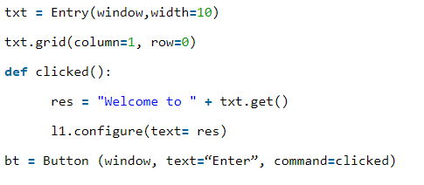
… Cont’d
3. Entry Widget: It is used to create input fields in the GUI to take in textual input.
Check out the example code shown below:
Here, we are creating a textbox using the Tkinter entry class. The grid tells the code where we want the widget on the window.
What should happen when the button is clicked?
Well, we have a message that says ‘Welcome to’ and later whatever is input into the text area will be concatenated along with this and printed.

Slide 13
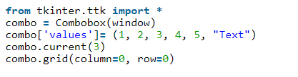
… Cont’d
4. Combobox Widget : it is just a drop-down menu with certain options.
Here’s the code snippet:
So check out that there are no other parameters for the combobox definition apart from the window.
And in the next line, we have defined certain values such numbers ranging from 1 to 5 and next, we have text. 1 to 5 were numeric inputs but we can have a textual input too.
It is defined using double quotes and we later will set the selected input.
Followed by that, we have the grid function to place the widget on the window.

Slide 14

… Cont’d
5. Checkbutton Widget: The checkbutton is widely used in almost all the sites.
So basically we use the checkbutton class to create the widget.
We start by creating a variable of the type booleanvar.
But this is not a standard python variable, correct? Well nothing to worry, this is a Tkinter variable.
By default, we keep the set state to be true which means that the button is checked already.
And next, we are passing chk_state to the checkbutton class to set the check state for us.

Slide 15
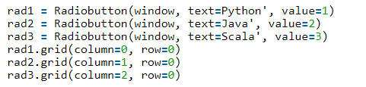
… Cont’d
6.Radio Button Widget:
The radio button widget is quite popular and We will use the radiobutton class to add the widget.
Here, we have the value parameters to be different. 1,2 and 3. However, if they are same, it will lead to conflict and there will be an error.
So it is to be noted that a unique value is used to address the radio buttons.
The value should be unique but the textual data can be the same, however. Here we have considered Python, Java, and Scala.
From the above output, note that unlike a checkbutton where you can try selecting multiple, here in case of radio button you can only select one at a time.

Slide 16
… Cont’d
7. Scrolled Text Widget:
Another nice widget we have is the scrolled text widget. This can be added using the scrolled text class.
Code :
One thing you must note here which is very important is that you need to specify the width and the height of the scrolled text widget. Well if we do not specify the same, the entire window is filled up.
You can set the scrolled text content by using the insert method. The syntax is pretty simple. We need to use txt.insert with the message as a parameter.

Slide 17


… Cont’d
8. Message Box Widget:
Let us quickly walk through this simple widget. We are using the messagebox library here as well
Code:
Importing the library and displaying the message. But we need to define the message title and the message content here.
Here we have made use of two of the widgets we learnt. We are using a button click to show a message box for us.

Slide 18
Geometry Management
All widgets in the Tkinter will have some geometry measurements. These measurements give you to organize the widgets and their parent frames, windows and so on.
Tkinter has the following three Geometry Manager classes.
pack():- It organizes the widgets in the block, which mean it occupies the entire available width. It’s a standard method to show the widgets in the window.
grid():- It organizes the widgets in table-like structure.
place():- It places the widgets at a specific position you want.
We already looked at the grid in almost all of the previous codes. If you have any doubts, head to the comment section and leave a comment, let’s interact there.

Slide 19
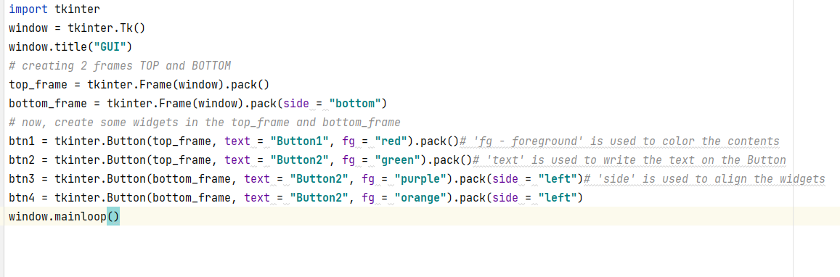
Organizing Layouts And Widgets
To arrange the layout in the window, we will use Frame, class. Steps:-
Frame creates the divisions in the window. You can align the frames as you like with side parameter of pack() method.
Button creates a button in the window. It takes several parameters like text (Value of the Button), fg (Color of the text), bg (Background color)
In the below code, we use to place in the window, top_frame, bottom_frame.

Slide 20
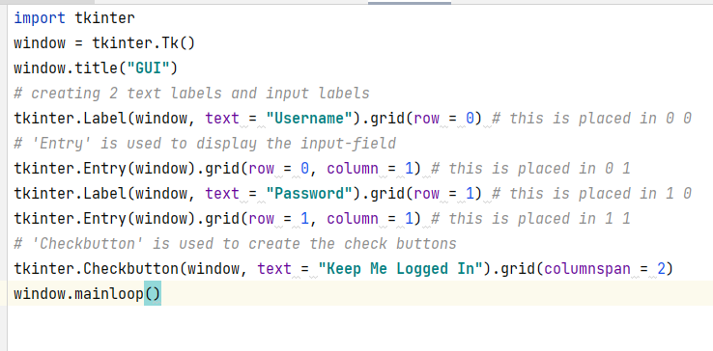
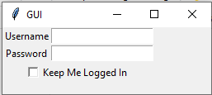
… Cont’d
See the below example to get an idea of how it works.
Output

Slide 21
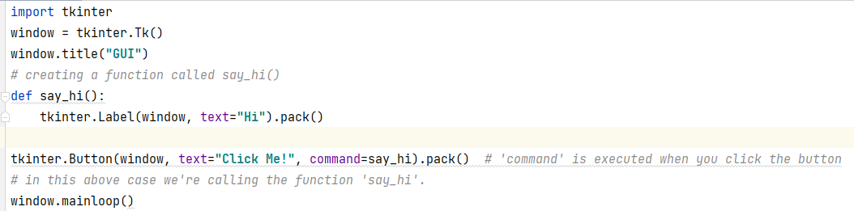
Binding Functions
Calling functions whenever an event occurs refers to a binding function.
In the below example, when you click the button, it calls a function called say_hi.
Function say_hi creates a new label with the text Hi.

Slide 22
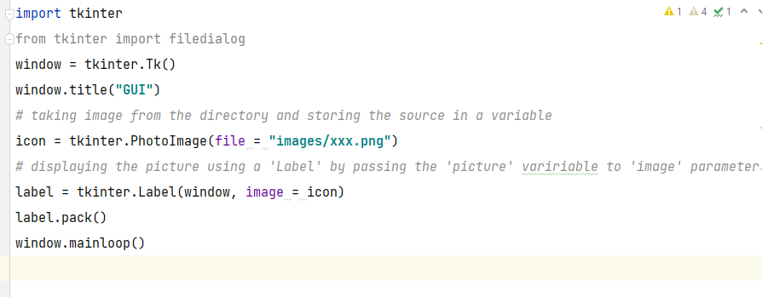
Images And Icons
In Tkinter GUI,you can add Images and Icons using PhotoImage method.

Slide 23
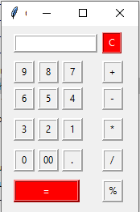
Simple Calculator GUI
Calculator GUI

Slide 24
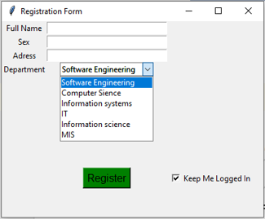
Quiz (5%)
Write a python code that creates the following Graphical User Interface (GUI)?

Slide 25
THANK YOU!
ANY QUESTIONS?

